Slide 1


PERFORMANCE APPRAISAL

Slide 2

DEFINITION
Performance appraisal
According to Flippo, a prominent personality in the field of Human resources, "performance appraisal is the systematic, periodic and an
impartial rating of an employee’s excellence in the matters pertaining to his present job and his potential for a better job."

Slide 3
NEED OF PERFORMANCE EVALUATIONS
Provide a review of past work performance.
Establish lines of communication.
Create an opportunity to discuss professional development goals and objectives.

Slide 4
Document employee performance.
Document corrective action necessary to improve work performance.
It is the supervisor’s and manager’s responsibility to monitor, evaluate and coach employees.

Slide 5






AIMS OF PERFORMANCE
APPRAISAL
Give employee feedback.
Identify employee training need
Document criteria.
Form a basis for personnel: salary increases, promotions, disciplinary actions, bonuses, etc.
Provide the opportunity for organizational diagnosis and development
Facilitate communication
Validate selection techniques and human resource policies.

Slide 6

PURPOSES OF PERFORMANCE APPRAISAL
To review the performance of the employees.
To judge the gap between the actual and the desired performance.
To help the management in exercising organizational control.
To diagnose the training and development needs of the future.

Slide 7
Provide information to assist in the HR decisions like promotions, transfers etc.
Provide clarity of the expectations and responsibilities of the functions to be performed by the employees.
To judge the effectiveness of the other human resource functions.
To reduce the grievances of the employees.
Helps to strengthen the relationship and communication between superior – subordinates and management – employees.

Slide 8

OBJECTIVES OF PERFORMANCE APPRAISAL

Slide 9

WORK RELATED OBJECTIVES
–To provide a control for work done
–To improve efficiency
–To help in assigning work and plan future work assignment; and
–To carry out job evaluation

Slide 10
CAREER DEVELOPMENT OBJECTIVES
To identify strong and weak points and encourage finding remedies for weak points through training;
To determine career potential;
To plan developmental( promotional or lateral) assignments; and
To plan career goals

Slide 11


OBJECTIVES OF COMMUNICATION
To provide adequate feedback on performance;
To clearly establish goals, i.e what is expected of the staff members in terms of performance and future work assignments;
To provide counseling and job satisfaction through open discussion on performance and
To let employees assess where they stand within the organization in terms of their performance.

Slide 12

ADMINISTRATIVE OBJECTIVES
To serve as a basis for promotion or demotion;
To serve as a basis for allocating incentives;
To serve as a basis for determining transfers ; and
To serve as a basis for termination in case of reduction of staff.

Slide 13




USE OF PERFORMANCE
APPRAISAL SYSTEM
Personnel Decisions( e.g. promotion, transfer, dismissal)
Identification of training needs
Raises, Merit Pay, Bonuses
Research purposes

Slide 14





ELEMENTS OF PERFORMANCE APPRAISAL
Setting performance
goals and objectives
Amendment to goals and objectives
Determining key competencies
Feedback of results.
Measurement of performance against the goals and objectives
Measurement of performance against key competencies,

Slide 15

CHARACTERISTICS OF EFFECTIVE PERFORMANCE APPRAISAL
The philosophy, purpose, and objectives of the organization are clearly stated so that performance appraisal tools can be designed to reflect these.
The purposes of performance appraisal are identified, communicated, and understood.
Job descriptions are written in such a manner that standards of job performance can be identified for each job.

Slide 16

The appraisal tool used is suited to the purposes for which it will be utilized and is accompanied by clear instructions for its use.
Evaluators are trained in the use of the tool.
The performance appraisal procedure is delineated, communicated and understood.
Plans for policing the appraisal procedure and evaluating appraisal tools are developed and implemented.

Slide 17

Performance appraisal has the full support of top management.
Performance appraisal is considered to be fair and productive by all who participate in it.

Slide 18

OBSTACLES TO EFFECTIVE PERFORMANCE APPRAISAL
Lack of support from top management.

Slide 19




RESISTANCE ON THE PART OF EVALUATOR BECAUSE:
Performance appraisal demands too much of supervisors efforts in terms of time, paperwork, and periodic observation of
subordinates’ performance.
Supervisors do not fully understand the purposes and procedures of performance appraisal.

Slide 20



Supervisors lack skills in appraisal techniques.
Performance appraisal is not perceived as being productive.
Evaluator biases and rating errors.
Lack of clear, objective standards of performance.
Failure to communicate purposes and
Lack of suitable appraisal tool.
Failure to police the appraisal procedure effectively.

Slide 21


WHEN ARE PERFORMANCE EVALUATIONS SUPPOSED TO
HAPPEN

Slide 22

HOW?

Slide 23

Step by step Guide to Performance Appraisals
Develop performance standards
Setting goals and objectives Data collection
Performance appraisal interview
Future goals and objectives
Follow up Rewarding performance

Slide 24

A.DEVELOP THE STANDARDS FOR EVALUATION
Performance standards are:
Based on the position, not the individual
Observable, specific indicators of success
Meaningful, reasonable and attainable
Describe “fully satisfactory” performance once trained
Expressed in terms of quantity, quality, timeliness, cost, safety or outcomes

Slide 25
B. SETTING OBJECTIVES
Specific
Performance oriented
Realistic
Observable

Slide 26

C. DATA COLLECTION
Sources of performance information
Personal observation
Reports, documentation, correspondence. Etc.
Feedback (internal and external)
Periodic discussions with employee

Slide 27

D. PERFORMANCE APPRAISAL INTERVIEW
Review standards, documentation and job description as well as the appraisal form and various ratings.
Write the appraisal ( Complete the Performance Appraisal Form).
Know the person’s record thoroughly.
Prepare the employee in advance.

Slide 28

Guidelines for conducting the interview
Establish a friendly, helpful, purposeful tone at the outset of the discussion. Be at ease.
Ask for the subordinate’s opinion of his or her performance since the last appraisal.
Recognize the staff nurse’s accomplishments and contributions to the hospital.
Be ready to suggest specific developmental activities suitable to each employee’s needs.
Make sure that the session is truly a discussion.

Slide 29

List disagreements: if possible, disagreements should be resolved before the end of the interview.
Make certain that your employees fully understand your appraisal of their performance.
Discuss the future as well as the past. Plan with the employee specific changes in performance or specific developmental activities that will allow fuller use of potential.
End the discussion on a positive, future – improvement- oriented note.
Document the conclusions.

Slide 30
E. FUTURE GOALS AND OBJECTIVES
At the end of the interview, the employer should allow some time to create a development plan.
The employer should record specific goals, targets or benchmarks that the employee will attempt to achieve.
Both employer and employee should agree on the steps to be taken to achieve these targets,
Both should agree on how the employee’s progress towards these objectives will be measured and set a defined timeframe, even if this is simply the next performance appraisal.

Slide 31

F. FOLLOW UP
Follow up means more than simply conducting regular formal performance reviews once a year.
If employers review employees and provide feedback as part of everyday management, both employers and the employee will learn much more about their strengths, weaknesses and how employers would prefer the job to be done.

Slide 32

G. THE PERFORMANCE EVALUATION REPORT
Class specification and / or informal job description.
Job standards, procedures and regulations.
Established goals, objectives and expectations.
Knowledge and abilities to perform the job.
Job relationships required for successful performance, i.e supervisors, co-workers, county employees and the public.

Slide 33

Quality of work, including the nature and consequences of errors made during the evaluation period.
Production rate, if applicable.
Commendations awarded relative to employee performance.
Use of job skills and efforts to enhance skills.
Ability to work with others.
Attendance, use of sick leave, punctuality.

Slide 34
Questions to consider when preparing to write the performance report:
Did the employee meet or exceed quantity and quality standards?
Does the employee have the skills to perform the job?
Has the employee increased skill level and established value to the organization?
If corrective action was instituted due to errors and
/or complaints that damaged the efficiency of organizational operations, was it effective?

Slide 35
Has the employee demonstrated job related efficiency through special efforts and capabilities?
Does the employee follow organizational rules and standards of the department?
Does the employee utilize supervisory guidance?

Slide 36

Guidelines for the writing of the Employee Performance Report
Establishing objectivity in written performance evaluations by avoiding vague subjective terminology.
Use specific job related terms and clearly define intent of comments.
Avoid the use of personal “traits” such as integrity, loyalty, honesty, initiative, etc. Measure employee performance against the job specifications.

Slide 37






H. REWARDING PERFORMANCE
Rewarding performance means providing incentives to, and recognition of, employees for their performance and acknowledging their
contributions to the agency’s mission.

Slide 38
Outstanding ( Level 5): Eligible for an individual cash award up to 5% of base pay; a Quality Sleep Increase; Time Off Award ; or other appropriate equivalent recognition. Additionally, may be eligible for a salary increase of up to 5% from the Human Resource Fund or as per organization’s policy.
Exceeds Expectations (Level 4): Eligible for an individual cash award up to 3 % of base pay; Time –Off Award, non-momentary award or other appropriate equivalent recognition.

Slide 39

Competent (Level 3): Eligible for awards such as monetary, non- momentary, Time –off, or other appropriate equivalent recognition, given for reasons: other than sustained performance tied to the rating of record.
Minimally Successful (Level 2): Ineligible for any performance recognition.
Unsatisfactory (Level 1): Ineligible for any performance recognition.

Slide 40
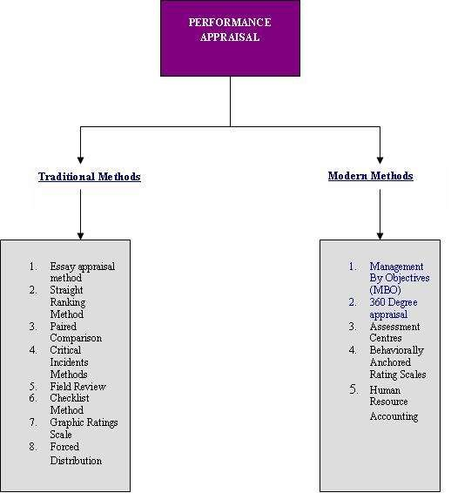
METHODS OF APPRAISING
PERFORMANCE

Slide 41
Traditional methods of
performance appraisal

Slide 42

1. Essay appraisal method
This traditional form of appraisal, also known as "Free Form method" involves a description of the performance of an employee by his superior.
The description is an evaluation of the performance of any individual based on the facts and often includes examples and evidences to support the information.
A major drawback of the method is the inseparability of the bias of the evaluator.

Slide 43
2. Straight ranking method
This is one of the oldest and simplest techniques of performance appraisal.
In this method, the appraiser ranks the employees from the best to the poorest on the basis of their overall performance.
It is quite useful for a comparative evaluation.

Slide 44
Professional Performance Standard 3: Education: The oncology nurse acquires and maintains current knowledge in oncology nursing practice.
Criteria: Rating
 | 1 | 2 | 3
1. Participates in ongoing educational activities (including inservices, continuing education, formal education, and experientatil learning) to expand oncology knowledge of professional issues
2. Seeks experiences to develop & maintain clinical skills

Slide 45

3. Paired comparison
A better technique of comparison than the straight ranking method, this method compares each employee with all others in the group, one at a time.
After all the comparisons on the basis of the overall comparisons, the employees are given the final rankings.

Slide 46
6. Checklist method
The rater is given a checklist of the descriptions of the behaviour of the employees on job.
The checklist contains a list of statements on the basis of which the rater describes the on the job performance of the employees.

Slide 47


4. Critical incidents methods
In this method of Performance appraisal the evaluator rates the employee on the basis of critical events and how the employee behaved during those incidents.
It includes both negative and positive points.
The drawback of this method is that the supervisor has to note down the critical incidents and the employee behavior as and when they occur.

Slide 48

5. Field review
In this method, a senior member of the Human Resource department or a training officer discusses and interviews the supervisors to evaluate and rate their respective subordinates.
A major drawback of this method is that it is a very time consuming method.
But this method helps to reduce the superiors’ personal bias.

Slide 49
7. Graphic rating scale
In this method, an employee’s quality and quantity of work is assessed in a graphic scale indicating different degrees of a particular trait.
The factors taken into consideration include both the personal characteristics and characteristics related to the on the job performance of the employees.
For example a trait like Job Knowledge may be judged on the range of average, above average, outstanding or unsatisfactory.

Slide 50
8. Forced Distribution
To eliminate the element of bias from the rater’s ratings, the evaluator is asked to distribute the employees in some fixed categories of ratings like on a normal distribution curve.
The rater chooses the appropriate fit for the categories on his own discretion

Slide 51

Modern methods of
performance appraisal

Slide 52

1. Assessment centres
An assessment centre typically involves the use of methods like social/informal events, tests and exercises, assignments being given to a group of employees to assess their competencies to take higher responsibilities in the future.
Generally, employees are given an assignment similar to the job they would be expected to perform if promoted.
The trained evaluators observe and evaluate employees as they perform the assigned jobs and are evaluated on job related characteristics.

Slide 53
2. Behaviorally anchored rating scales
Is a relatively new technique which combines the
graphic rating scale and critical incidents method.
It consists of predetermined critical areas of job performance or sets of behavioral statements describing important job performance qualities as good or bad.
In this method, an employee’s actual job behavior is judged against the desired behavior by recording and comparing the behavior with BARS.

Slide 54

3. Human resource accounting method
Human resources are valuable assets for every organization. Human resource accounting method tries to find the relative worth of these assets in the terms of money.
In this method the Performance appraisal of the employees is judged in terms of cost and contribution of the employees.

Slide 55

The cost of employees include all the expenses incurred on them like their compensation, recruitment and selection costs, induction and training costs etc whereas their contribution includes the total value added (in monetary terms).
The difference between the cost and the contribution will be the performance of the employees.
Ideally, the contribution of the employees should be greater than the cost incurred on them.

Slide 56
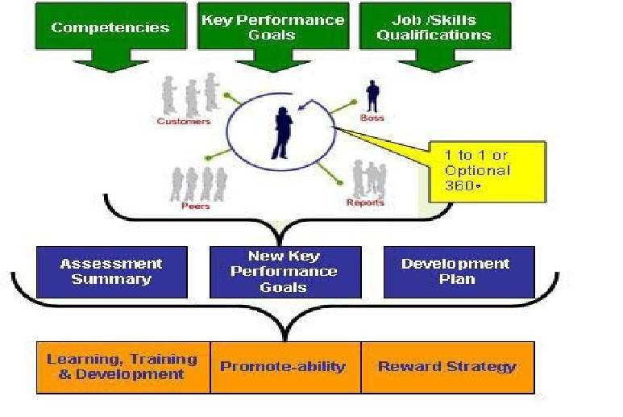
4. 360-Degree-performance- appraisal method

Slide 57
360 degree feedback, also known as 'multi-rater feedback', is the most comprehensive appraisal where the feedback about the employees’ performance comes from all the sources that come in contact with the employee on his job

Slide 58
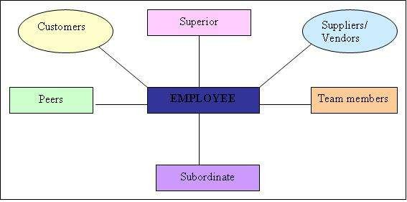
360 degree appraisal has four integral components:
Self appraisal
Superior’s appraisal
Subordinate’s appraisal
Peer appraisal.

Slide 59
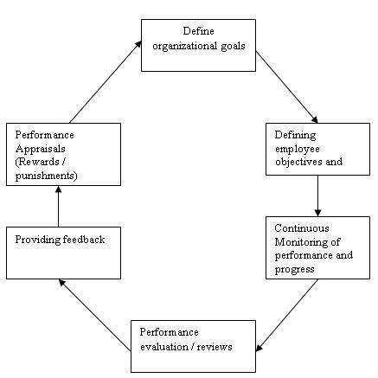
„Management by Objectives‟ (MBO)

Slide 60

Clarity of goals – With MBO, came the concept of SMART goals i.e. goals that are:
Specific Measurable Achievable Realistic, and Time bound

Slide 61


















ERRORS IN WRITING PERFORMANCE EVALUATIONS
The “ halo effect”
The “pitchfork effect” or “ recency effect”.
“Stereotyping”
“Comparing”
“Mirroring”
Managers and supervisors want to avoid being the “ bad guy”.

Slide 62

EFFECTIVE MANAGEMENT OF PERFORMANCE APPRAISAL
The system should be simple, effective, efficient and administratively feasible.
The procedures and uses of the system should be understood and agreed on by line management and the employees being rated.
Factors to be rated should be measurable and agreed on by managers and subordinates.
Raters should understand the purpose and nature of the performance review.

Slide 63

They should be taught to the use the system, observe, and write notes, including
critical incident file, organize notes and write evaluations that include examples of
evidence, edit their reports and conduct effective review interviews.
Raters should understand the meanings of the dimensions rated, including the dimensions’ relative weights. Managers are reported to be able to distinguish among only three levels of performance: poor, satisfactory, and outstanding.
Criticism should promote warmth and the building of self esteem for both rate and rater.

Slide 64

The process should be organized and used to manage employees on a daily basis according to their needs to be coached.
Praise or suggestions for improvement should be done at the time of the event.
Standards of performance should be set and modified at the time of the event.
Performance standards should be valid, reliable and fair.
Managers should be rewarded for good performance evaluation skills.

Slide 65
QUALITIES OF A GOOD
APPRAISAL
It is Factual
It is Fair
It describes the Whole Period
It describes the Whole Job
It has no Surprises

Slide 66
BENEFITS OF PERFORMANCE APPRAISAL

Slide 67

Benefit for the individual:
Gaining a better understanding of their role
Understanding more clearly how and where they fit in within the wider picture
A better understanding of how performance is assessed
and monitored
Getting an insight
Improving understanding of their strengths and weaknesses and developmental needs
Identifying ways in which they can improve performance
Providing an opportunity to discuss and clarify developmental and training needs
Understanding and agreeing their objectives for the next
year
An opportunity to discuss career direction and prospects.

Slide 68


Benefit to the line/ manager/supervisor/team leader:
Oppurtunities to
hear and exchange views and opinions away from the normal pressure of work
to identify any potential difficulties or weaknesses
An improved understanding of the resources available
to plan for and set objectives for the next period
to think about and clarity their own role
to plan for achieving improved performance
to plan for further delegation and coaching
to motivate members of the team

Slide 69
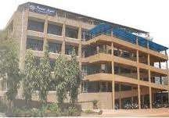
Benefits to the organization
A structured means of identifying and assessing potential
Up-to-date information regarding the expectations and aspirations of employees
Information on which to base decisions about promotions and motivation
An opportunity to review succession planning

Slide 70
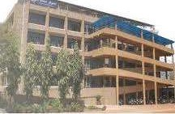
Information about training needs which can act as a basis for developing training plans
Updating of employee records ( achievements, new competencies, etc)
Career counseling
Communication of information

Slide 71
PERFORMANCE APPRAISAL FOR EMPLOYEES AT DIFFERENT LEVELS
For top level management
Degree of organizational growth and expansion
Extent of achievement of organizational goal
Contribution towards the society
Profitability and return on capital employed

Slide 72

For middle level managers
Performance of the departments or teams
Co-ordination with other departments
Optimal use of resources
Costs Vs. revenues for a given period of time
The communication with superiors and subordinates

Slide 73
The following are the major discrepancies found in the performance appraisal processes being followed at the government organizations.
Most of the indicators used for measuring the performance the employees are not quantifiable in nature, making it difficult to measure the performance.
Due to the lack of accountability and job security, most government employees have a laisser faire attitude towards their work.
Unavailability of the job descriptions for many employees

Slide 74

For front line supervisors
Quantity of actual output against the targets
Quality of output against the targets
Number of accidents in a given period
Rate of employee absenteeism

Slide 75
PERFORMANCE APPRAISAL IN GOVERNMENT ORGANIZATIONS
The most common method of Performance appraisal that is used in most of the government organizations is Confidential report (popularly known as CR) written by the superior of the employees.

Slide 76
Most of the objectives in government organizations are unchallenging, unrealistic and not timely reviewed and updated.
It is difficult to measure the average performance of the government employees.
Unprofessional and unstructured approach towards the process.
There is often a lot of bias and subjectivity involved in the ratings given by the superiors.
Lack of complete information on appraisal forms due to expertise and relevant training; often, the appraisals are not conducted on a regular basis.

Slide 77
In government organizations, team appraisal is often not possible.
Other HR decisions like rewards, training or promotions are not directly linked to the results of the performance appraisal process.

Slide 78
ROLE OF ADMINISTRATOR
IN PERFORMANCE APPRAISAL
Manage and supervise the work of others, directly and through subordinate managers.
Appraise performance.
Counsel and train employees, directly and through subordinate managers.
Monitors smooth functioning of performance appraisal in the department.

Slide 79
Understand, interpret and apply laws, rules, regulations and policies related to Performance appraisal.
Develop and implement disciplinary actions as necessary.
Collect, interpret and evaluate narrative and other data pertaining to Performance appraisal.

Slide 80
Marshburn, D.M. et. Al. (2009) in her study, examined the relationship between 265 new nurse’s perceptions and measured performance based clinical competence in an academic medical care centre in Greenville, using Descriptive co-relational designs to examine the relationships. Performance based clinical competence was measured by the Performance Based Development System developed by Del Bueno (1990). She reported that nurse’s who scored high on perception scores also scored high performance scales. There was a relationship between new nurse’s perceptions of clinical competence and a performance based measures of clinical competence.

Slide 81
Prepare complex reports and other written materials of Performance appraisal.
Analyze and resolve complex problems related to appraisal.
Communicate clearly and concisely, both orally and in writing; present findings, of Performance appraisal to employees.
Provide excellent interpersonal relations with employees.
Maintains performance appraisal records and reports of all employees working under her/him.

Slide 82
RESEARCH RELATED TO PERFORMANCE APPRAISAL
Harcourt M. & Narcisse S.(2008) conducted a study on Employee Fairness Perceptions of performance appraisal. The researcher identified the essential factors which influence employees’ fairness perceptions of their performance appraisals, and determined the applicability of these factors to the experiences of employees in a Saint Lucian public service organization. A qualitative case study method was used to gain understanding of employee perceptions of the fairness of their performance appraisals. Data obtained from both completed appraisal forms and interviews with 20 employees was transcribed and assessed using a thematic analysis. Overall, results showed that justice factors influence employee perceptions of fairness in their appraisals. Results suggested that employees also consider four additional justice factors, the consistency in reward distribution,
appraisal frequency, job relevant criteria and rater and rate training.

Slide 83
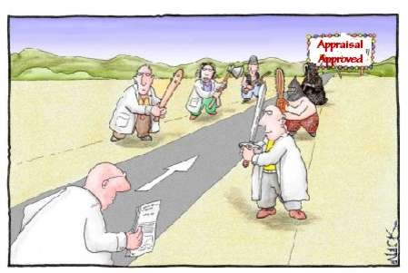
THANK YOU
A good process is the foundation of your success”

